Slide 1
Human Resource Management
Matiar Rahman

Slide 2
Content
Contribution Registers
Salary Rule Categories
Salary Rules
Salary Structures
Contracts
Meal Bills
Mobile Bill Limits
Mobile Bills
Loan Proof
Loan Policies
Loan Type
Loan Request
Loan Approval
Loan Disbursement
Employee Payslip
Batch Payslip

Slide 3
How to Create Contribution Register

Slide 4
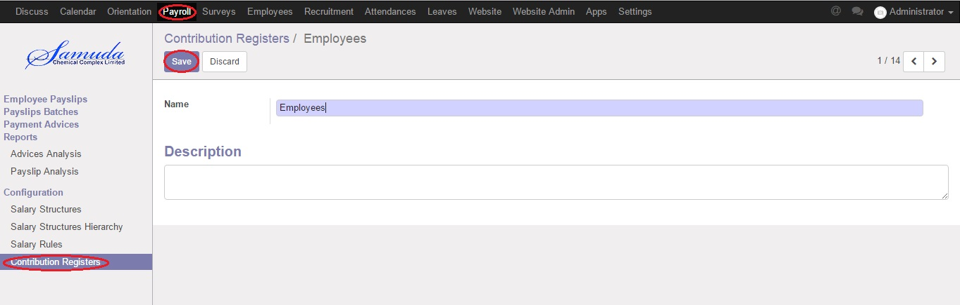
Create Contribution Register
Payroll >> Contribution Registers >> Create

Slide 5
How to Create Salary Rule Category

Slide 6
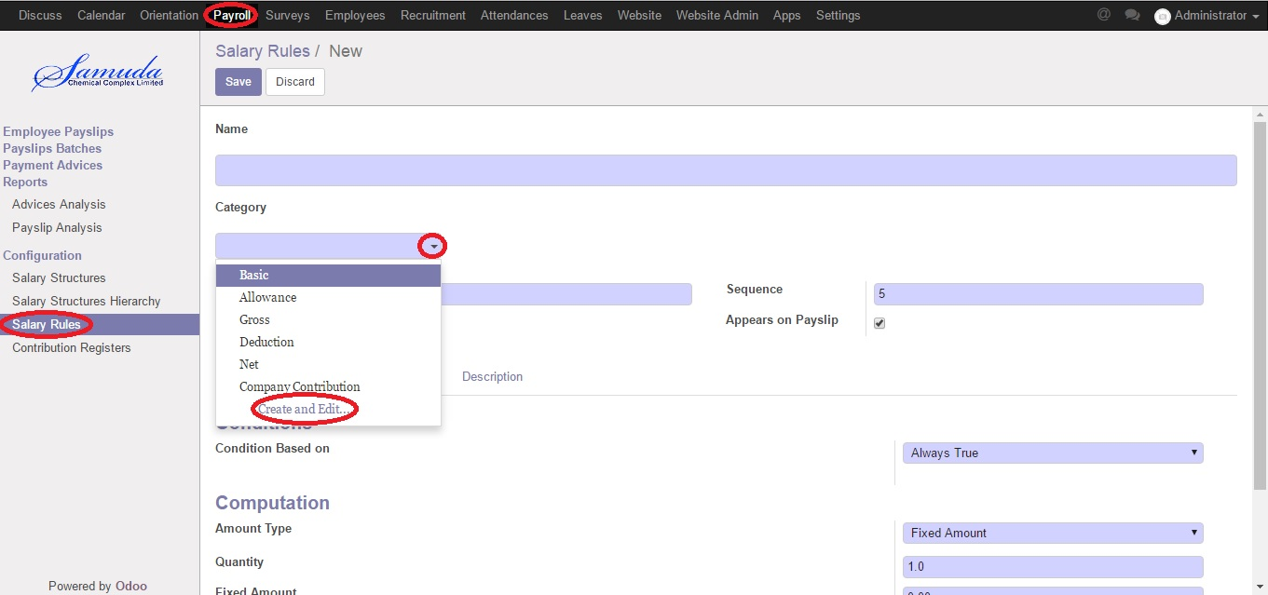
Create Salary Rule Categories
Payroll >> Salary Rule Categories >> Create

Slide 7
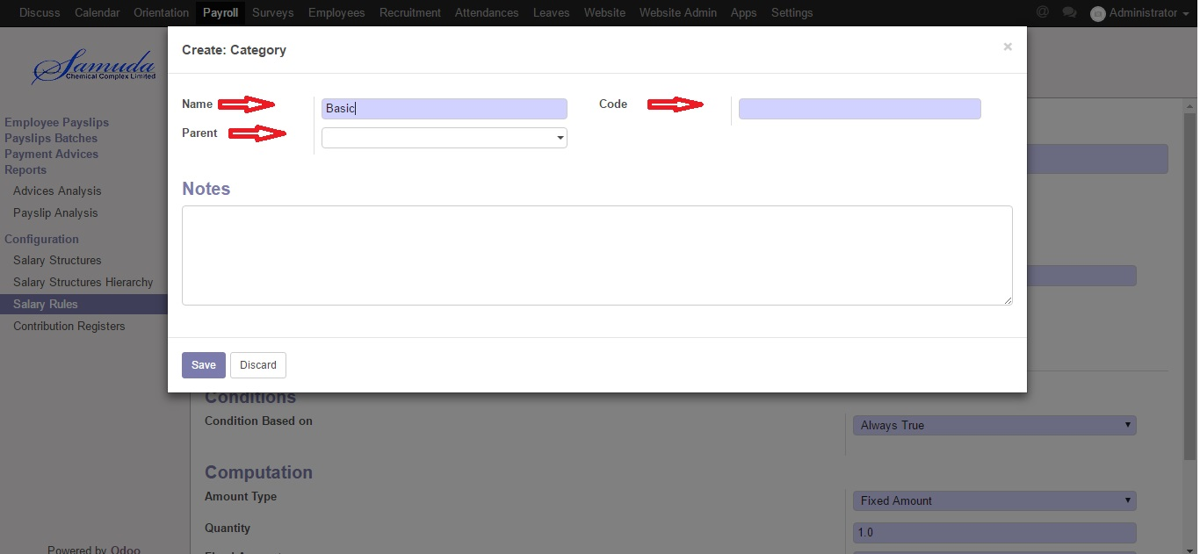
Create Salary Rule Categories
Payroll >> Salary Rule Categories >> Create

Slide 8
How to Create Salary Rules

Slide 9
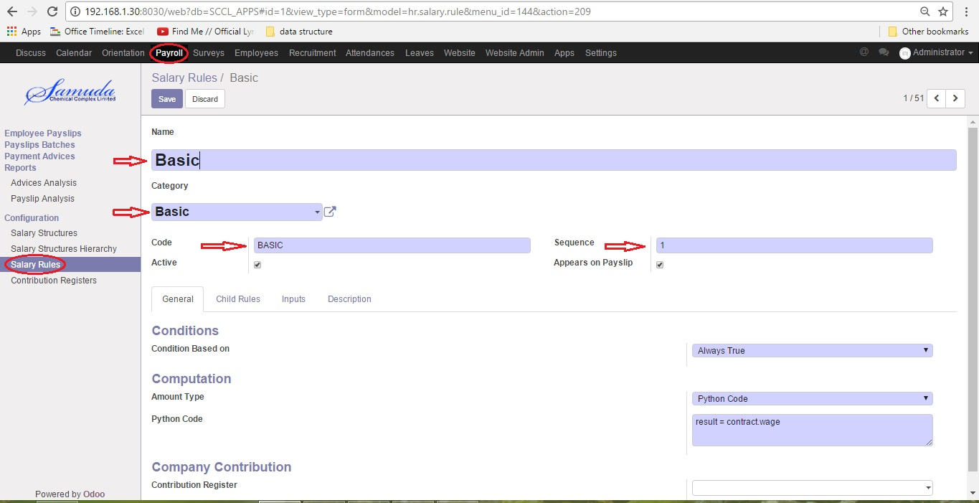
Create Salary Rules
Payroll >> Salary Rules >>Create

Slide 10
How to Create Salary Structures

Slide 11
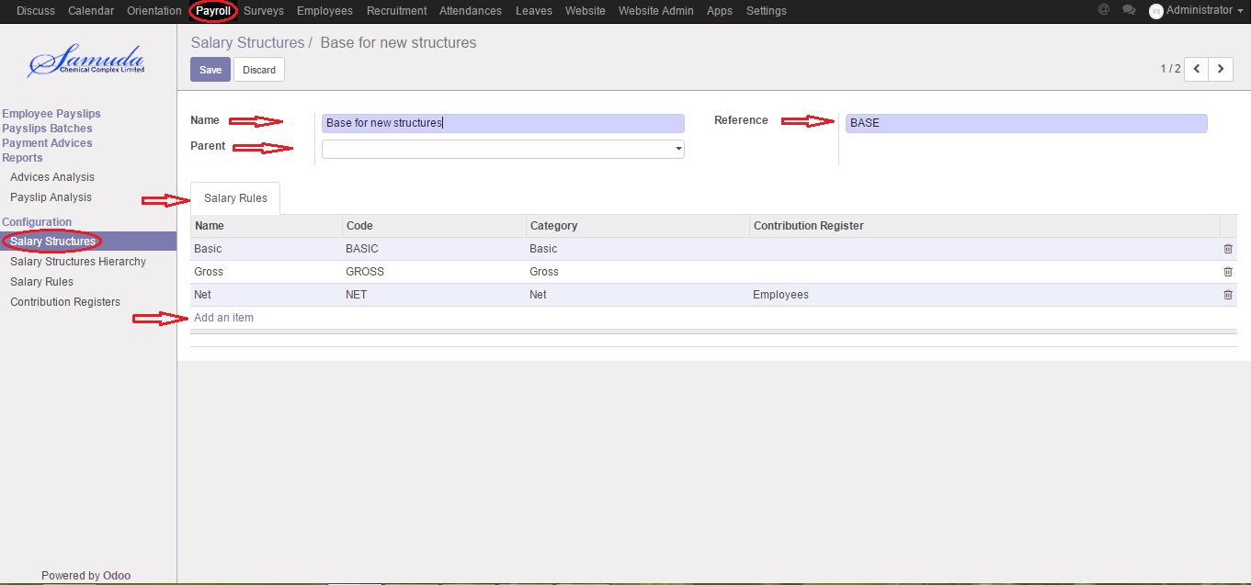
Create Salary Structures
Payroll >> Salary Structure >>Create

Slide 12
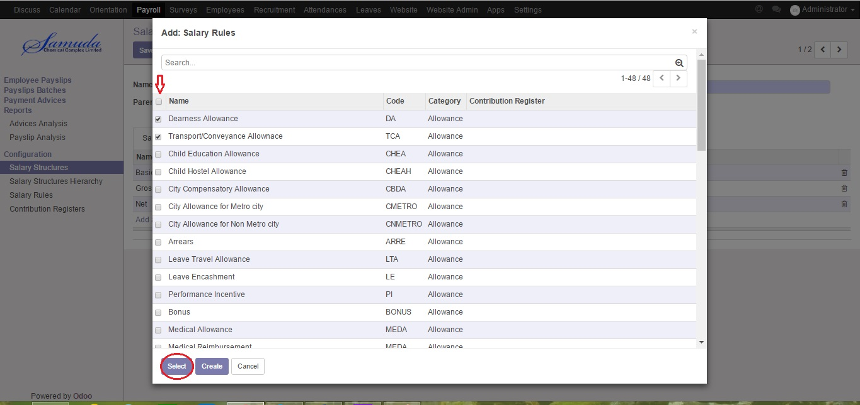
Create Salary Structures
Payroll >> Salary Structure >>Create

Slide 13
How to Create Contracts

Slide 14
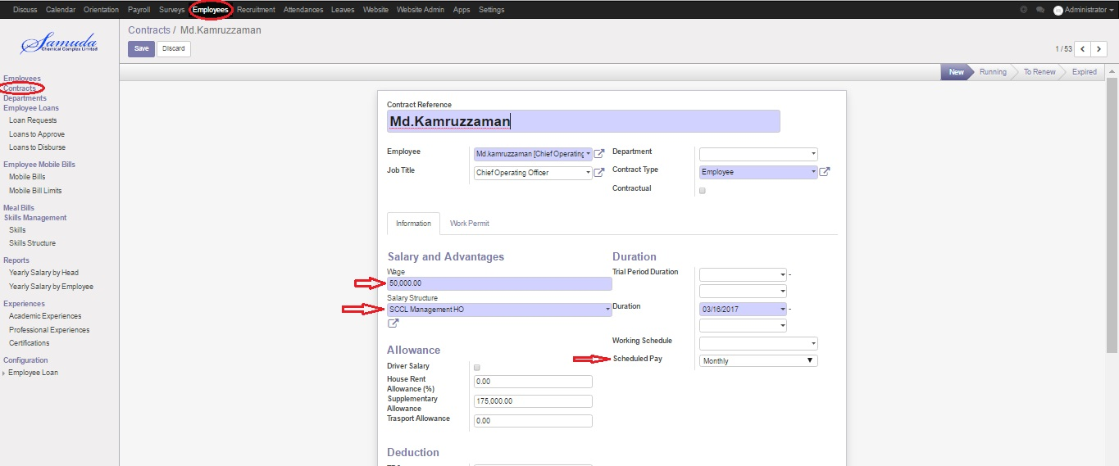
Create Contracts
Employees >> Contracts >>Create

Slide 15
How to Create Meal Bills

Slide 16
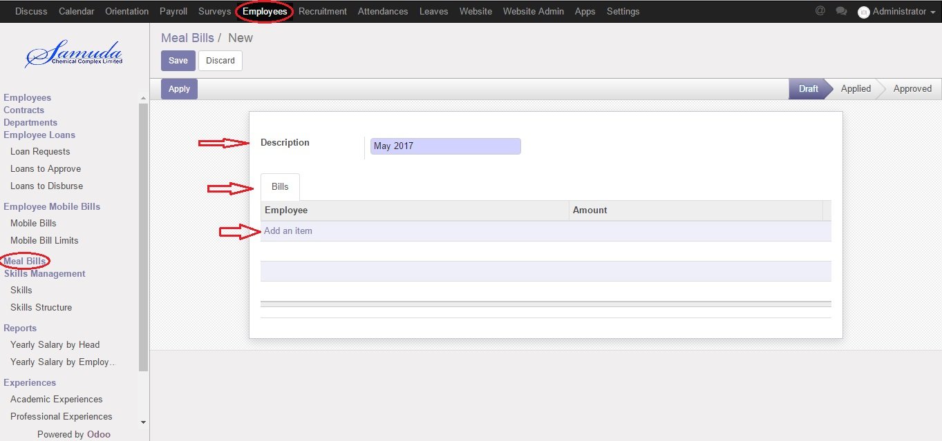
Create Meal Bills
Employees >> Meal Bills >>Create

Slide 17
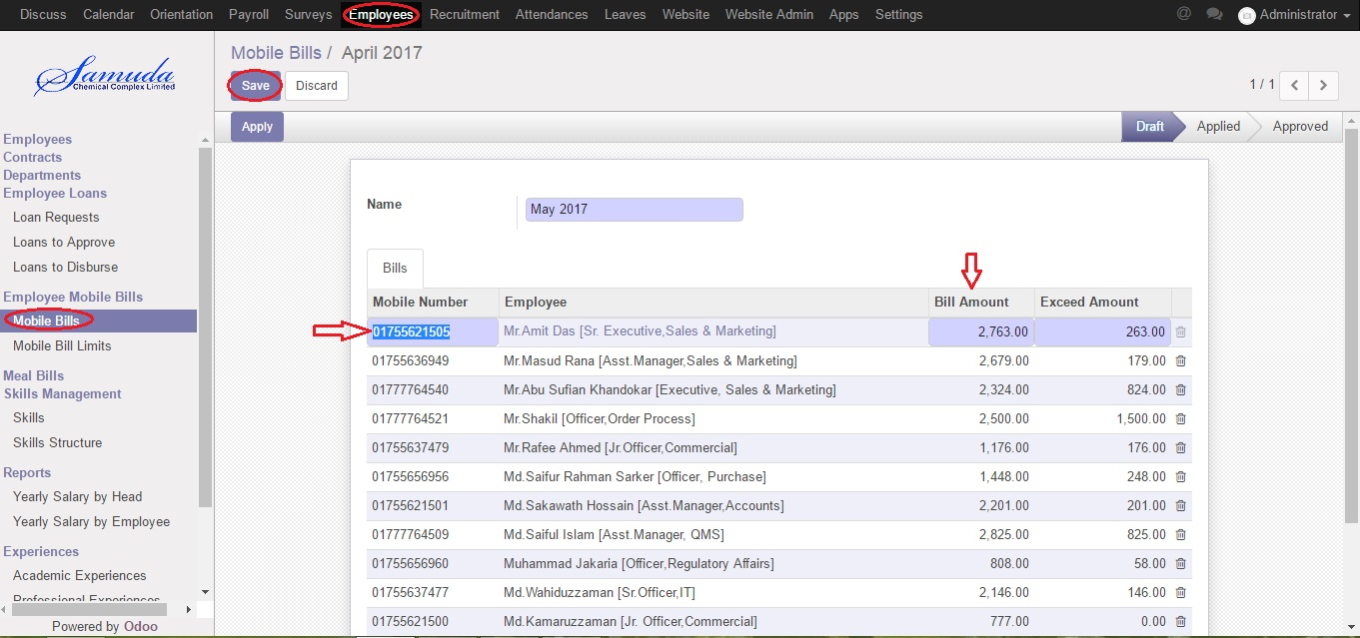
Create Meal Bills
Employees >> Meal Bills >>Create

Slide 18
How to Create Mobile Bill Limits

Slide 19
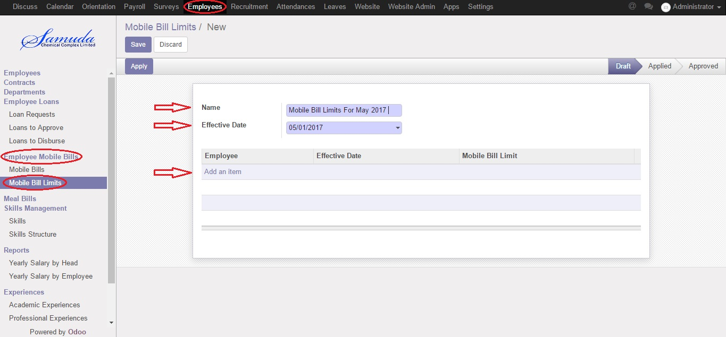
Create Mobile Bill Limits
Employees >> Employee Mobile Bills >> Mobile Bill Limits >>Create

Slide 20
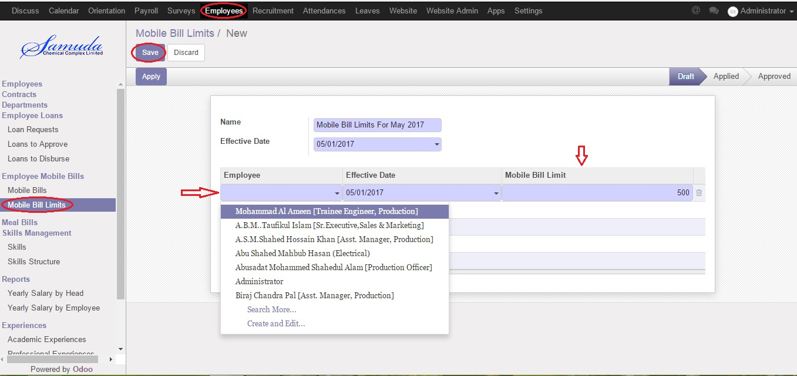
Create Mobile Bill Limits
Employees >> Employee Mobile Bills >> Mobile Bill Limits >>Create

Slide 21
How to Create Mobile Bills

Slide 22
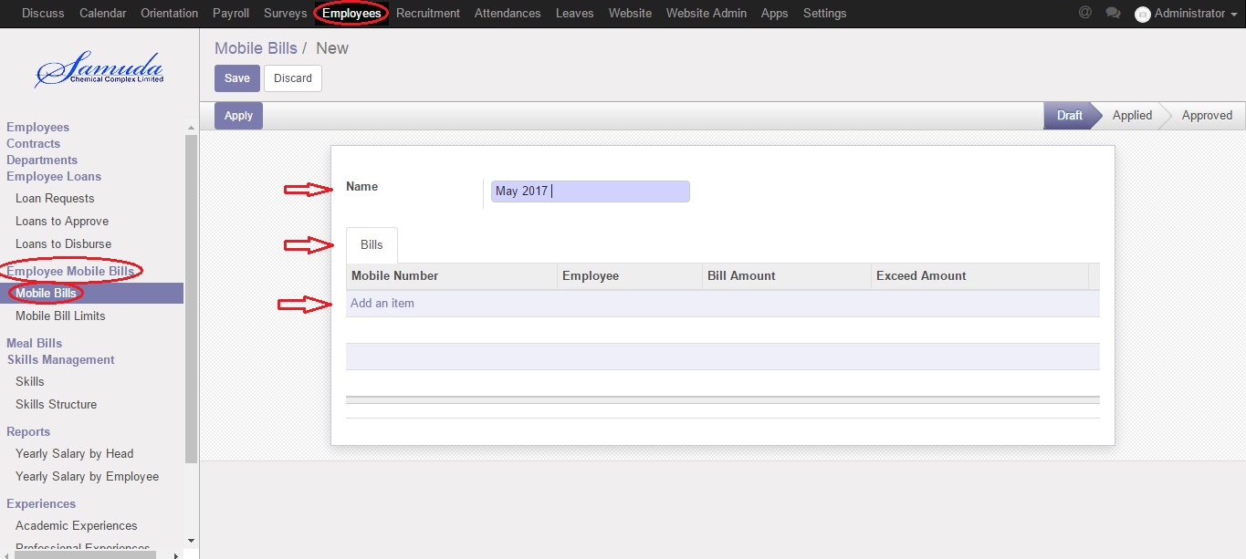
Create Mobile Bills
Employees >> Employee Mobile Bills >> Mobile Bills >>Create

Slide 23
Create Mobile Bills
Employees >> Employee Mobile Bills >> Mobile Bills >>Create

Slide 24
How to Create Loan Proof

Slide 25
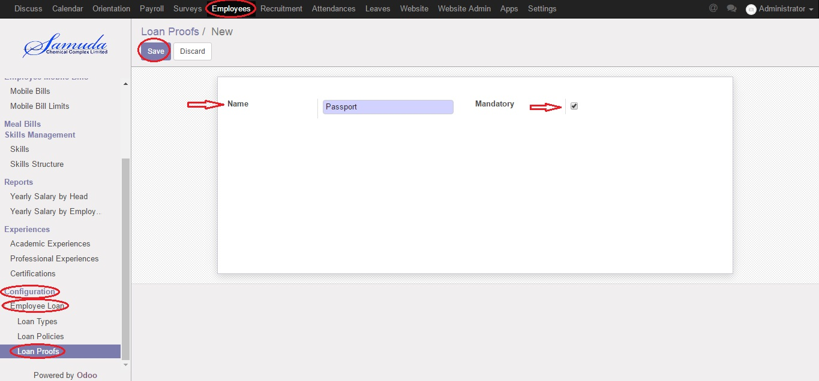
Create Loan Proof
Employee >> Configuration >> Employee Loan >> Loan Proofs >>Create

Slide 26
How to Create Loan Policies

Slide 27
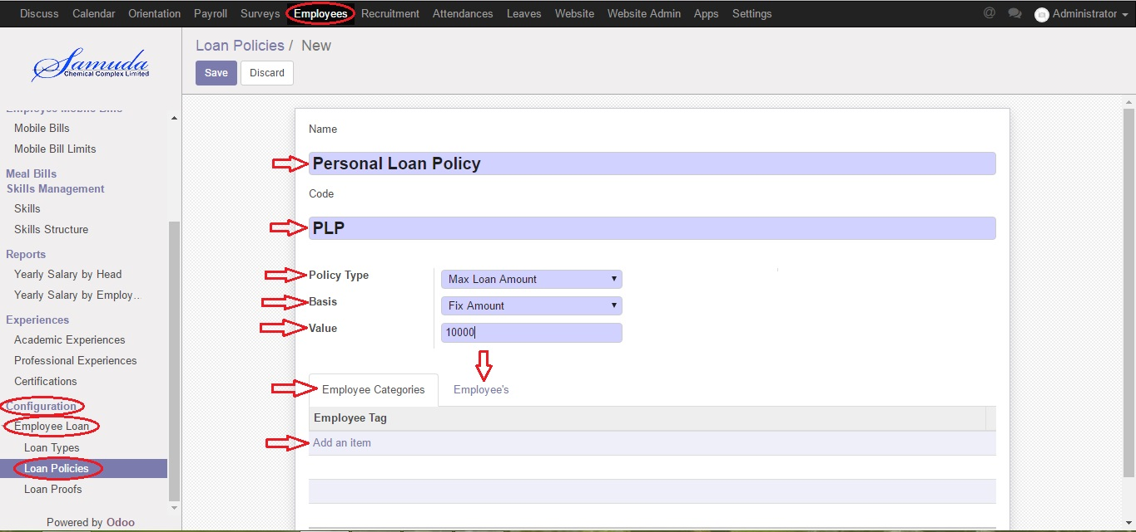
Create Loan Policies
Employee >> Configuration >> Employee Loan >> Loan Policies>>Create

Slide 28
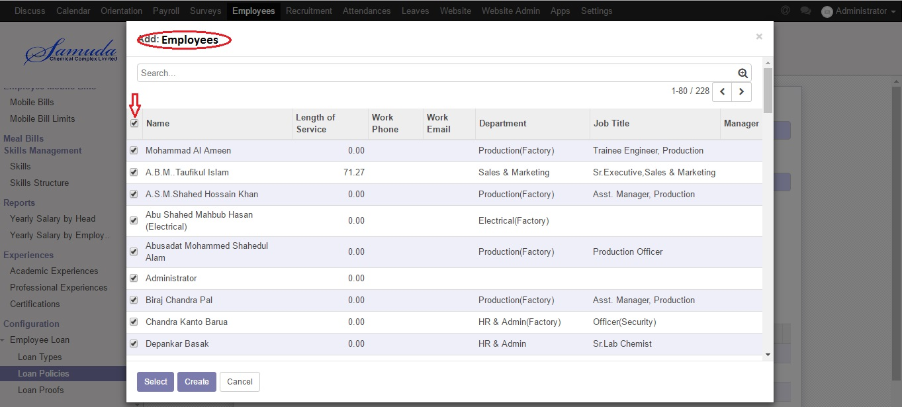
Create Loan Policies
Employee >> Configuration >> Employee Loan >> Loan Policies>>Create

Slide 29
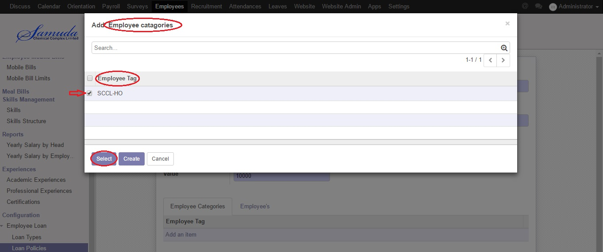
Create Loan Policies
Employee >> Configuration >> Employee Loan >> Loan Policies>>Create

Slide 30
How to Create Loan Type

Slide 31
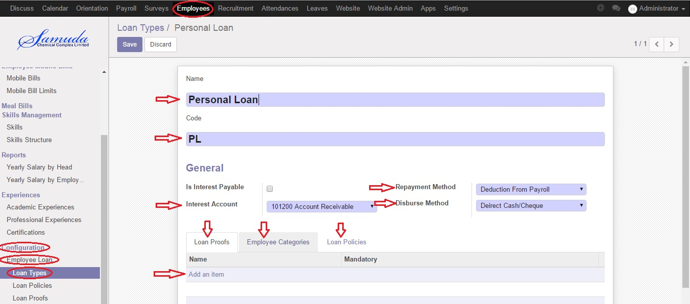
Create Loan Type
Employee >> Configuration >> Employee Loan >> Loan Type >>Create

Slide 32
Create Loan Type
Employee >> Configuration >> Employee Loan >> Loan Type >>Create

Slide 33
Create Loan Type
Employee >> Configuration >> Employee Loan >> Loan Type >>Create

Slide 34
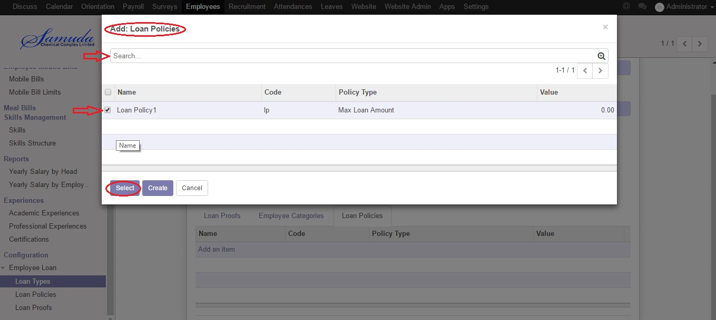
Create Loan Type
Employee >> Configuration >> Employee Loan >> Loan Type >>Create

Slide 35
How to Create Loan Request

Slide 36
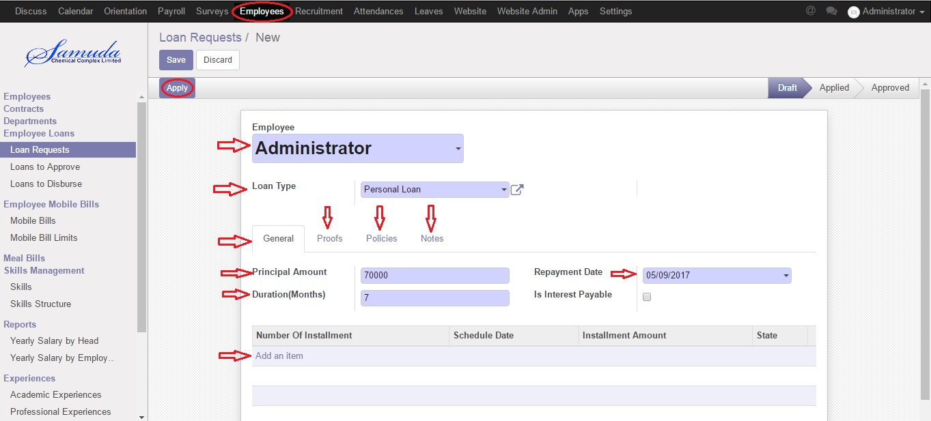
Create Loan Request
Employee >> Employee Loans >> Loan Requests >>Create

Slide 37
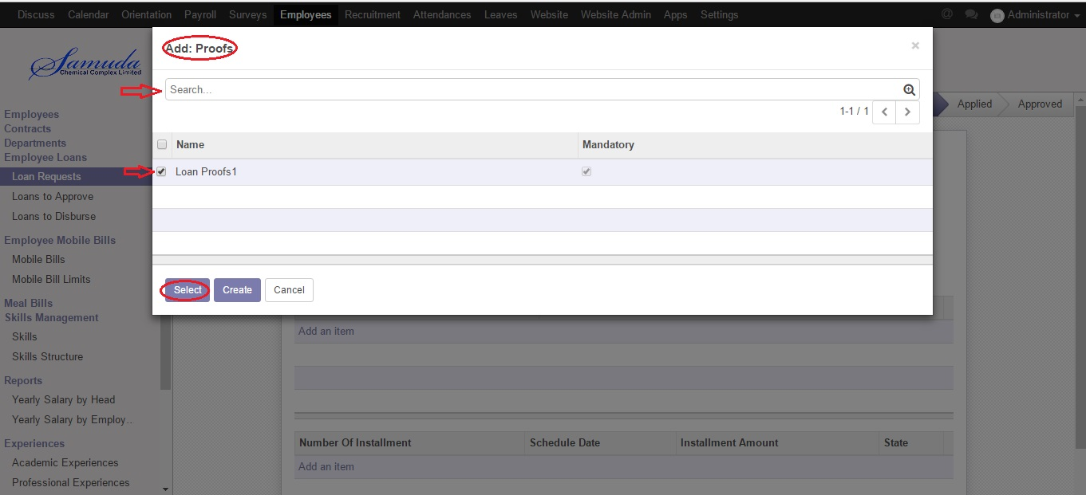
Create Loan Request
Employee >> Employee Loans >> Loan Requests >>Create

Slide 38
Create Loan Request
Employee >> Employee Loans >> Loan Requests >>Create

Slide 39
How to Create Loan Request to Approve

Slide 40
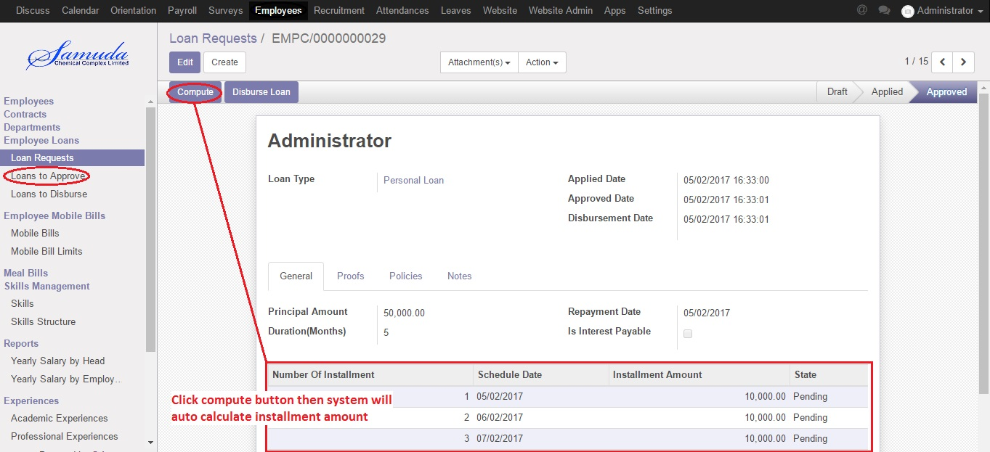
Create Loan Request to Approve
Employee >> Employee Loans >> Loan to Approve >> Create

Slide 41
How to Create Loan to Disburse by Accountant

Slide 42
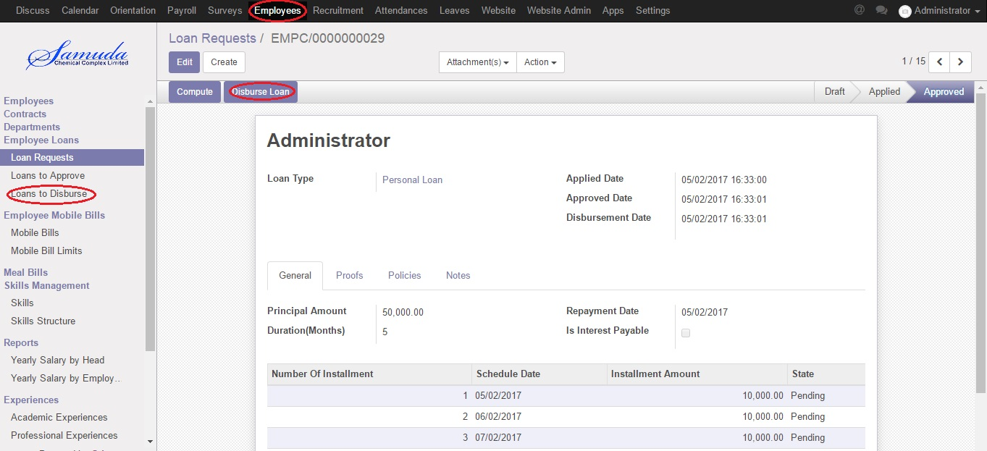
Create Loan to Disburse
Employee >> Employee Loans >> Loan to Disburse >> Create

Slide 43
How to Create Employee Paysilips

Slide 44
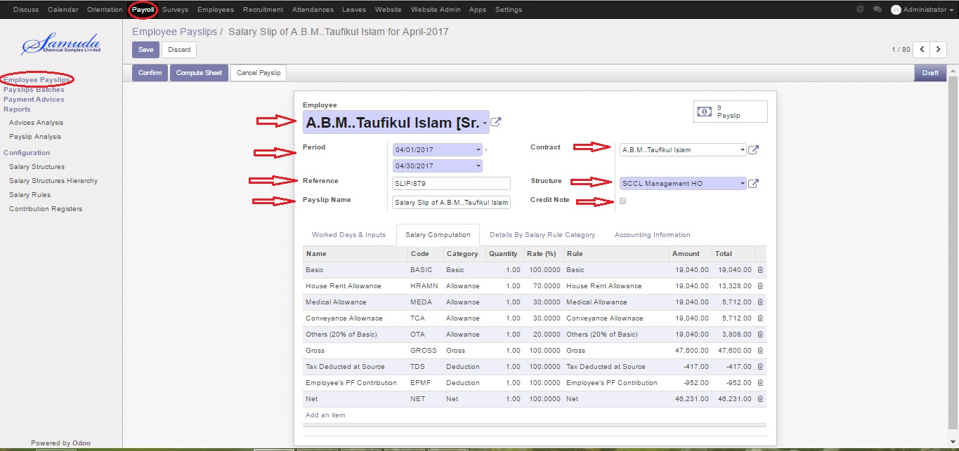
Create Employee Paysilips
Payroll >> Employee Payslips >> Create

Slide 45
How to Create Payslips Batches

Slide 46
Create Payslips Batches
Payroll >> Payslips Batches >> Create

Slide 47
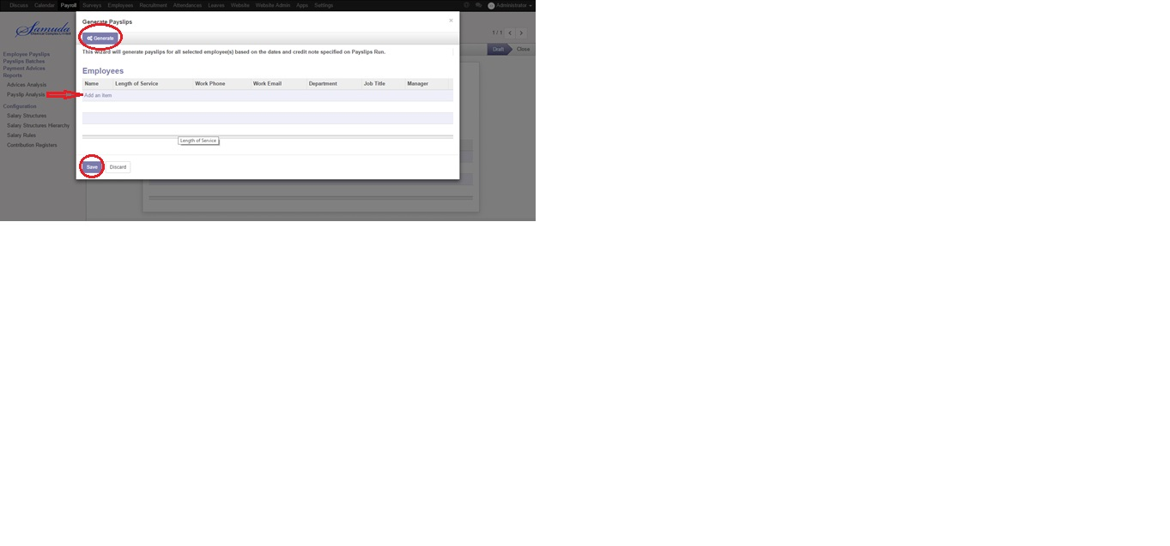
Create Payslips Batches
Payroll >> Payslips Batches >> Create

Slide 48
Thank You!

